Slide 1
Identity Operators & Membership Operators in python

Slide 2
Identity Operators
The membership operators are used to check if a value exists within an iterable (such as a list, tuple, string, or dictionary).
is
is not
The is operator checks whether two variables point to the same object in memory (i.e., they are the same object).
The is not operator checks whether two variables do not refer to the same object in memory.

Slide 3
Membership Operators
The identity operators are used to compare the memory location (or identity) of two objects to check if they are the exact same object in memory.
in
not in
The in operator is used to check whether a value is present in an iterable.
The not in operator checks if a value is not present in an iterable.

Slide 4
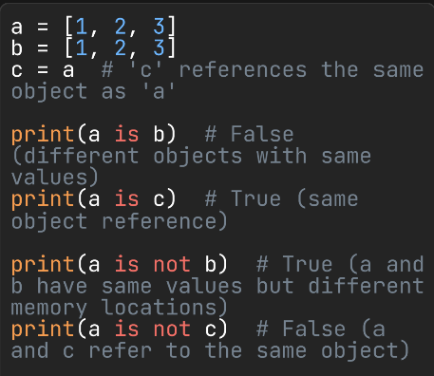
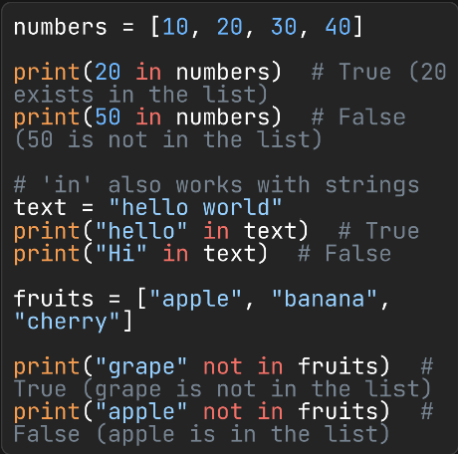
is / is not in / not in

Slide 5
Thank You
Ghaniya Khan
03323118076
ghaniyaakhann08@gmail.com
ghaniyakhan

